Slide 1
Request Time Off
at CMSD

Slide 2
Workday@CMSD
Workday functions have been configured for CMSD use, highlighting some functions and turning others off.
This slide deck outlines the differences between the Workday system demonstrated in the video and the functions we are using at CMSD.

Slide 3
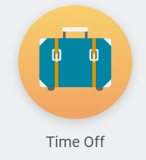
Request Time Off for Employees Video
Use the Worklet “Time Off” to request time off. The “Request Time Off” worklet will not be available

Slide 4
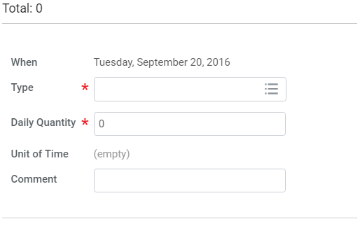
Request Time Off for Employees Video
The request time off daily quantity does not default to your work schedule. You will have to add the amount of time off you are requesting.

Slide 5
Request Time Off for Employees Video
For Teachers, Paras and Secretaries:
Requesting a sub for sick time is still done in Smart Find Express. The time off flows to the Workday Web Calendar.

Slide 6
Summary
That’s it!
As summary, at CMSD:
Employees select the “Time Off” worklet to request time off
The request time off daily quantity does not default to your work schedule
For teachers, paras & secretaries: Requesting a sub for sick time is still done in Smart Find Express. The time off flows to the Workday Web Calendar.

Slide 7

Thank you!

